Slide 1
Comparing Several Means: ANOVA (GLM 1)
Prof. Andy Field

Slide 2
Aims
Understand the basic principles of ANOVA
  Why it is done?
  What it tells us?
Theory of one-way independent ANOVA
Following up an ANOVA:
  Planned contrasts/comparisons
    Choosing contrasts
    Coding contrasts
  Post hoc tests

Slide 3
When and Why
When we want to compare means we can use a t-test. This test has limitations:
  You can compare only 2 means: often we would like to compare means from 3 or more groups.
  It can be used only with one predictor/independent variable.
ANOVA
  Compares several means.
  Can be used when you have manipulated more than one independent variable.
  It is an extension of regression (the general linear model).

Slide 4
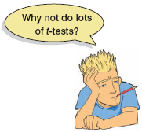
Why Not Use Lots of t-Tests?
If we want to compare several means why don’t we compare pairs of means with t-tests?
  Can’t look at several independent variables.
  Inflates the Type I error rate.
1
1
2
1
3
Vs
Vs
2
2
3
Vs
3

Slide 5
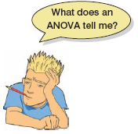
What Does ANOVA Tell Us?
Null hyothesis:
  Like a t-test, ANOVA tests the null hypothesis that the means are the same.
Experimental hypothesis:
  The means differ.
ANOVA is an omnibus test
  It test for an overall difference between groups.
  It tells us that the group means are different.
  It doesn’t tell us exactly which means differ.

Slide 6
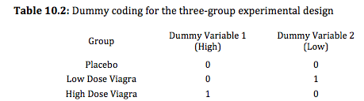
ANOVA as Regression

Slide 7
Placebo Group

Slide 8
High Dose Group

Slide 9
Low Dose Group

Slide 10
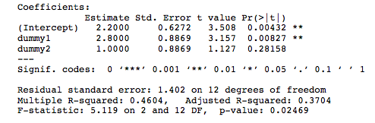
Output from Regression

Slide 11
Experiments vs. Correlation
ANOVA in regression:
  Used to assess whether the regression model is good at predicting an outcome.
ANOVA in experiments:
  Used to see whether experimental manipulations lead to differences in performance on an outcome (DV).
    By manipulating a predictor variable can we cause (and therefore predict) a change in behaviour?
  Asking the same question, but in experiments we systematically manipulate the predictor, in regression we don’t.

Slide 12
Theory of ANOVA
We calculate how much variability there is between scores
  Total sum of squares (SS_{T}).
We then calculate how much of this variability can be explained by the model we fit to the data
  How much variability is due to the experimental manipulation, model sum of squares (SS_{M})...
… and how much cannot be explained
  How much variability is due to individual differences in performance, residual sum of squares (SS_{R}).

Slide 13


Rationale to Experiments
Group 1
Group 2
Lecturing Skills
Variance created by our manipulation
  Removal of brain (systematic variance)
Variance created by unknown factors
  E.g. differences in ability (unsystematic variance)

Slide 14
Population
μ = 10
No Experiment
M = 10
M = 9
M = 11
M = 10
M = 9
M = 8
M = 12
M = 10
M = 11
Experiment

Slide 15
Theory of ANOVA
We compare the amount of variability explained by the model (experiment), to the error in the model (individual differences)
  This ratio is called the F-ratio.
If the model explains a lot more variability than it can’t explain, then the experimental manipulation has had a significant effect on the outcome (DV).

Slide 16
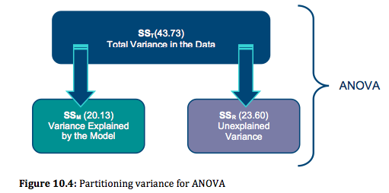
Theory of ANOVA
If the experiment is successful, then the model will explain more variance than it can’t
  SS_{M} will be greater than SS_{R}

Slide 17
ANOVA by Hand
Testing the effects of Viagra on libido using three groups:
  Placebo (sugar pill)
  Low dose viagra
  High dose viagra
The outcome/dependent variable (DV) was an objective measure of libido.

Slide 18
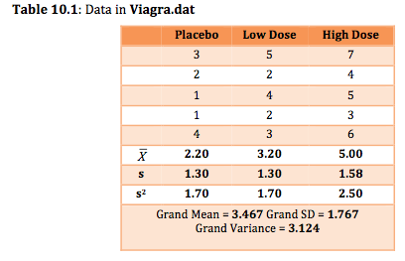
The Data

Slide 19
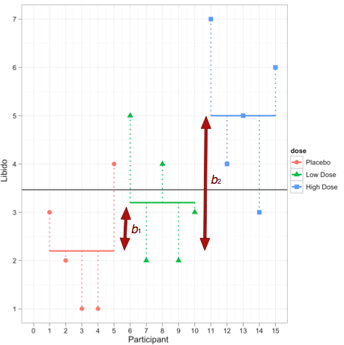
The data:

Slide 20
Total Sum of Squares (SS_{T}):
Grand Mean

Slide 21
Step 1: Calculate SS_{T}

Slide 22
Degrees of Freedom
Degrees of freedom (df) are the number of values that are free to vary.
  Think about rugby teams!
In general, the df are one less than the number of values used to calculate the SS.

Slide 23
Model Sum of Squares (SS_{M}):
Grand Mean

Slide 24
Step 2: Calculate SS_{M}

Slide 25
Model Degrees of Freedom
How many values did we use to calculate SS_{M}?
  We used the 3 means.

Slide 26
Residual Sum of Squares (SS_{R}):
Grand Mean
Df = 4
Df = 4
Df = 4

Slide 27
Step 3: Calculate SS_{R}

Slide 28
Step 3: Calculate SS_{R}

Slide 29
Residual Degrees of Freedom
How many values did we use to calculate SS_{R}?
  We used the 5 scores for each of the SS for each group.

Slide 30
Double Check

Slide 31
Step 4: Calculate the Mean Squared Error

Slide 32
Step 5: Calculate the F-Ratio

Slide 33
Step 6: Construct a Summary Table
Source | SS | df | MS | F
Model | 20.14 | 2 | 10.067 | 5.12*
Residual | 23.60 | 12 | 1.967
Total | 43.74 | 14

Slide 34
Why Use Follow-Up Tests?
The F-ratio tells us only that the experiment was successful
  i.e. group means were different
It does not tell us specifically which group means differ from which.
We need additional tests to find out where the group differences lie.

Slide 35
How?
Multiple t-tests
  We saw earlier that this is a bad idea
Orthogonal contrasts/comparisons
  Hypothesis driven
  Planned a priori
Post hoc tests
  Not planned (no hypothesis)
  Compare all pairs of means
Trend analysis

Slide 36
Planned Contrasts
Basic idea:
  The variability explained by the model (experimental manipulation, SS_{M}) is due to participants being assigned to different groups.
  This variability can be broken down further to test specific hypotheses about which groups might differ.
  We break down the variance according to hypotheses made a priori (before the experiment).
  It’s like cutting up a cake (yum yum!)

Slide 37
Rules When Choosing Contrasts
Independent
  Contrasts must not interfere with each other (they must test unique hypotheses).
Only two chunks
  Each contrast should compare only two chunks of variation (why?).
K–1
  You should always end up with one less contrast than the number of groups.

Slide 38
Generating Hypotheses
Example: Testing the effects of Viagra on libido using three groups:
  Placebo (sugar pill)
  Low dose viagra
  High dose viagra
Dependent variable (DV) was an objective measure of libido.
Intuitively, what might we expect to happen?

Slide 39
 | Placebo | Low Dose | High Dose
 | 3 | 5 | 7
 | 2 | 2 | 4
 | 1 | 4 | 5
 | 1 | 2 | 3
 | 4 | 3 | 6
Mean | 2.20 | 3.20 | 5.00

Slide 40
How do I Choose Contrasts?
Big hint:
  In most experiments we usually have one or more control groups.
  The logic of control groups dictates that we expect them to be different from groups that we’ve manipulated.
  The first contrast will always be to compare any control groups (chunk 1) with any experimental conditions (chunk 2).

Slide 41
Hypotheses
Hypothesis 1:
  People who take Viagra will have a higher libido than those who don’t.
  placebo ≠ (low, high)
Hypothesis 2:
  People taking a high dose of Viagra will have a greater libido than those taking a low dose.
  low ≠ high

Slide 42
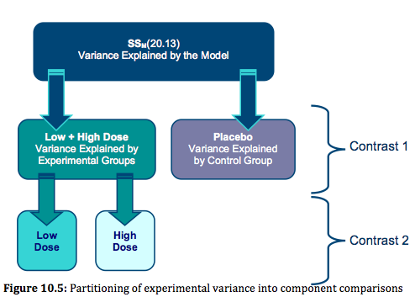
Planned Comparisons

Slide 43
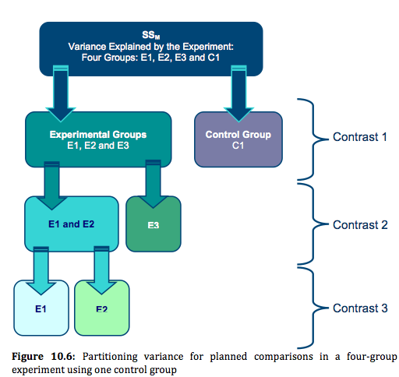
Another Example

Slide 44
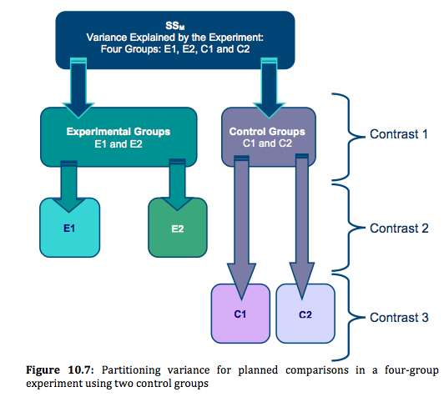
Another Example

Slide 45
Coding Planned Contrasts: Rules
Rule 1
  Groups coded with positive weights compared to groups coded with negative weights.
Rule 2
  The sum of weights for a comparison should be zero.
Rule 3
  If a group is not involved in a comparison, assign it a weight of zero.

Slide 46
Coding Planned Contrasts: Rules
Rule 4
  For a given contrast, the weights assigned to the group(s) in one chunk of variation should be equal to the number of groups in the opposite chunk of variation.
Rule 5
  If a group is singled out in a comparison, then that group should not be used in any subsequent contrasts.

Slide 47
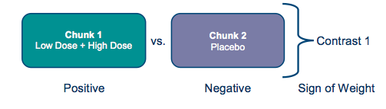

Slide 48
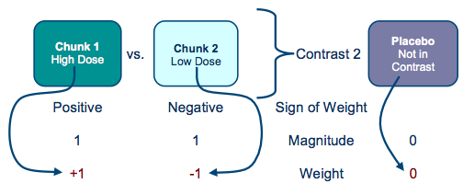

Slide 49
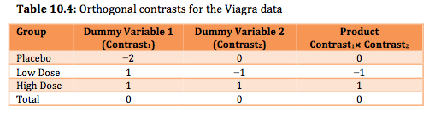
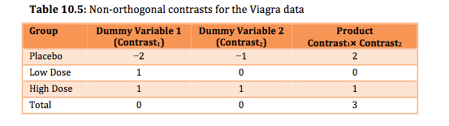

Slide 50
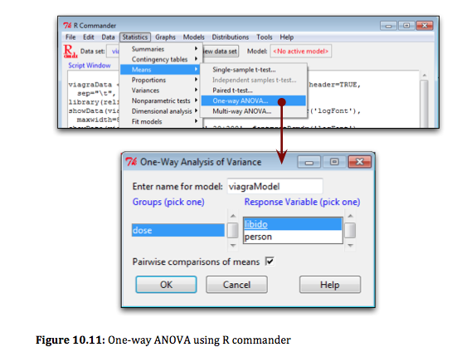
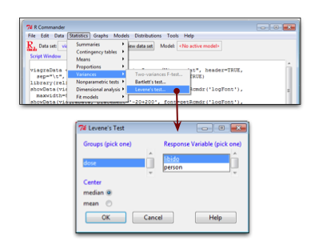
One-Way ANOVA Using
R Commander

Slide 51
One-Way ANOVA using R
When the Test Assumptions Are Met
Using lm():
  viagraModel<-lm(libido~dose, data = viagraData)
Using aov():
  viagraModel<-aov(libido ~ dose, data = viagraData)
  summary(viagraModel)

Slide 52
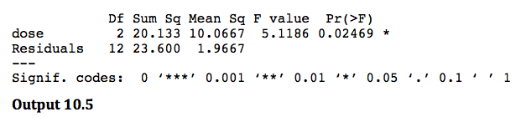
Output from aov()

Slide 53
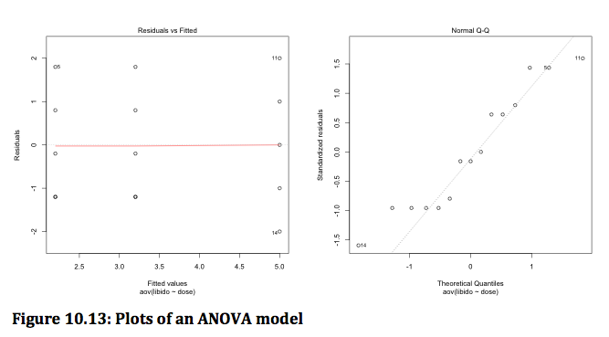
plot(viagraModel)

Slide 54
When variances are not equal across groups
If Levene’s test is significant then it is reasonable to assume that population variances are different across groups.
We can get the output for Welch’s F for the current data by executing:
  oneway.test(libido ~ dose, data = viagraData)

Slide 55

Output

Slide 56
Robust ANOVA
Require the data to be in wide format rather than the long format.
We can reformat the data using unstack():
  viagraWide<-unstack(viagraData, libido ~ dose)
This command creates a new dataframe called viagraWide, which is our Viagra data but in wide format, so each column represents a different group.

Slide 57
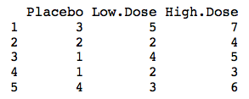
viagraWide

Slide 58
Robust ANOVA
For an ANOVA of the Viagra data based on 20% trimmed means:
  t1way(viagraWide)
To compare medians rather than means:
  med1way(viagraWide)
To add a bootstrap to the trimmed mean method:
  t1waybt(viagraWide)

Slide 59
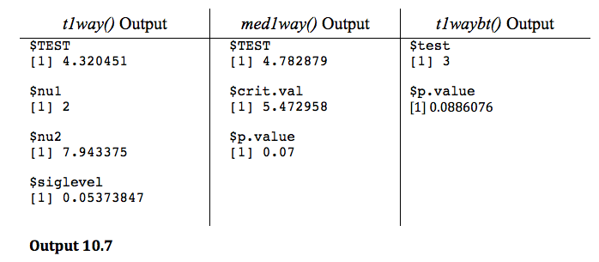
Robust Output

Slide 60
Planned Contrasts using R
To do planned comparisons in R we have to set the contrast attribute of our grouping variable using the contrast() function and then recreate our ANOVA model using aov(). By default, dummy coding is used.
We can see this if we summarise our existing viagraModel using the summary.lm() function rather than summary():
  summary.lm(viagraModel)

Slide 61
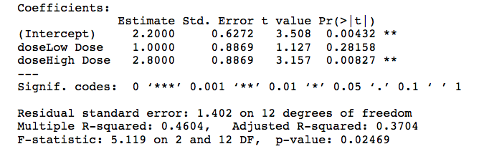
Output

Slide 62
Post Hoc Tests
Compare each mean against all others.
In general terms they use a stricter criterion to accept an effect as significant.
  Hence, control the familywise error rate.
  Simplest example is the Bonferroni method:

Slide 63
Post Hoc Tests Recommendations
How you conduct post hoc tests in R depends on which test you’d like to do.
Bonferroni and related methods such as the Holm and Benjamini–Hochberg (BH) variants are done using the pairwise.t.test() function, which is part of the R base system.
However, Tukey and Dunnett’s test can be done using the glht() function in the multcomp() package.
Finally, Wilcox (2005) has some robust methods implemented in his functions lincon() and mcpp20().

Slide 64
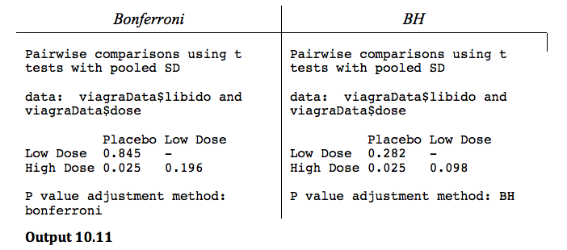
Bonferroni and BH post hoc tests
  pairwise.t.test(viagraData$libido, viagraData$dose, p.adjust.method = "bonferroni")
  pairwise.t.test(viagraData$libido, viagraData$dose, p.adjust.method = "BH")

Slide 65
Tukey
For the Viagra data, we can obtain Tukey post hoc tests by executing:
  postHocs<-glht(viagraModel, linfct = mcp(dose = "Tukey"))
  summary(postHocs)
  confint(postHocs)

Slide 66
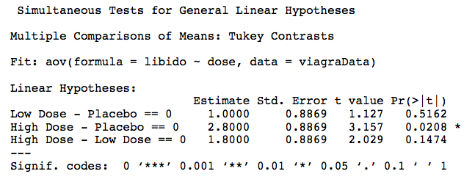
Output

Slide 67
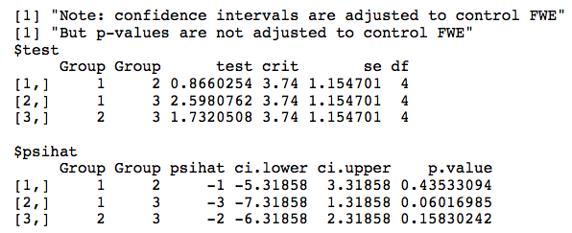
Robust post hoc tests
  lincon(viagraWide)
  mcppb20(viagraWide)

Slide 68
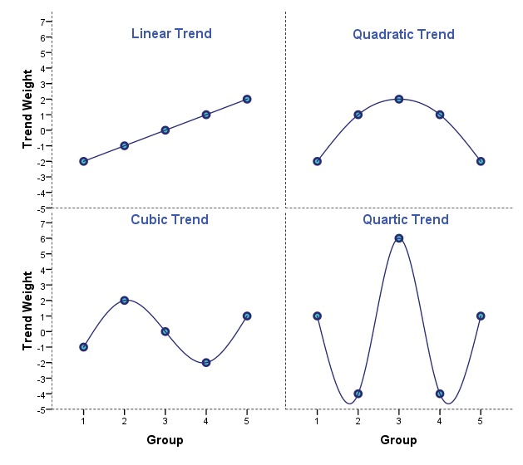
Polynomial Contrasts: Trend Analysis

Slide 69
Trend Analysis
Follow the general procedure of setting the contrast attribute of the predictor variable:
  contrasts(viagraData$dose)<-contr.poly(3)
We then create a new model using aov():
  viagraTrend<-aov(libido ~ dose, data = viagraData)
To access the contrasts:
  summary.lm(viagraTrend)

Slide 70
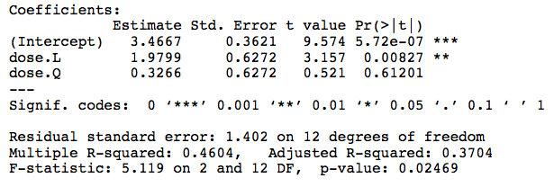
Trend Analysis: Output

Slide 71
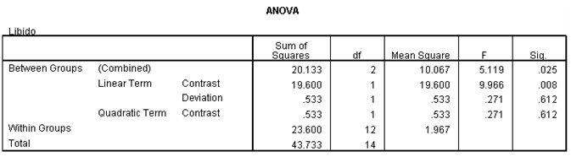
Trend Analysis: Output

